Slide 1



IOT Smart Metering Case Study
TEAM G
MEGHLA SARKAR
SAMARPAN DUTTA
UMAKANTH SAI BALGURI
SRI VENKATA VENU GOPAL GUDDATI
VANSHIKA KANWAR PARIHAR
Advance System Analysis & Design | Prof. Dr. Alan Hevner

Slide 2

Abstract
Electricity distributors trying to minimize the operational cost
In 2000, USA made its first trial to implement Smart Metering
Smart metering system being an IOT dependent infrastructure is prone to cybersecurity hacks
Compromised access to meters and leakage of consumption and uses statistics
Discusses competing alternatives to address security glitches
Outline a situation driven decision taking strategy to implement additional security

Slide 3
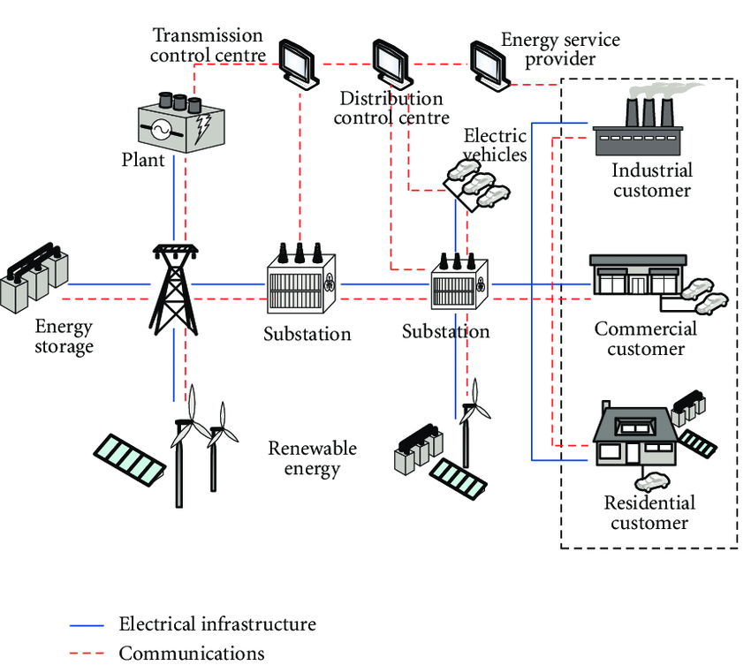
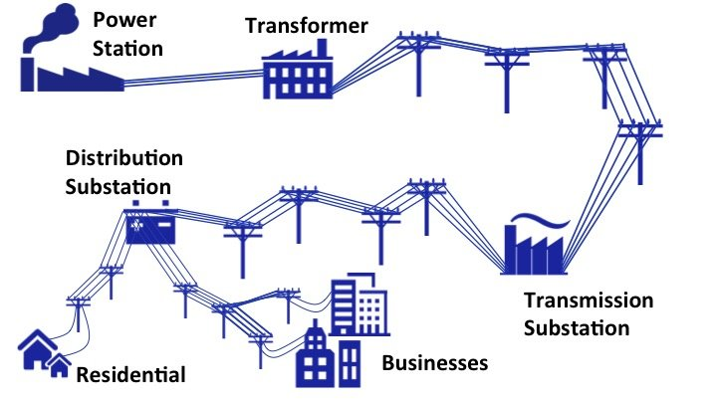
Why Smart Meters ?

Slide 4

The Context Problem
Cost
Security
Privacy
Cyber Attack
Key Drivers
Good planning from the start
Prepare your Organization
Keep it simple
Communicate with your customers
Logistics is at the core of the rollout

Slide 5
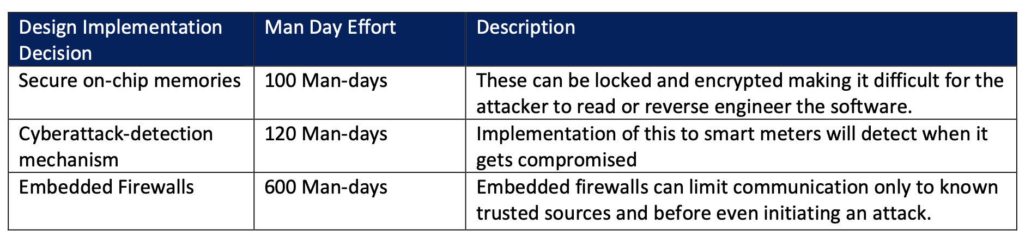

The Challenge- Unprecedented Design flaw
Brute force attack during testing compromised customer sensitive data
Need to improve Security
Security Architecture Engineer (SAE) suggests implementing three additional security requirements
820 Man-days of Design development.
Current Go-live date cannot change
Internal Security Team has only 50 Man-days as spare capacity.
Limited Additional Budget

Slide 6
And the Solution from the leader- Project Manager
Embedded Firewalls outsourced to Tampa Bay Consulting. (Fixed Price worth $50k )
“Secure on-chip memories” to be developed by internal security team overtime.
Graduates from USF were to be given the task of implementing “Cyberattack-detection mechanism” (Based on security teams positive experience)

Slide 7

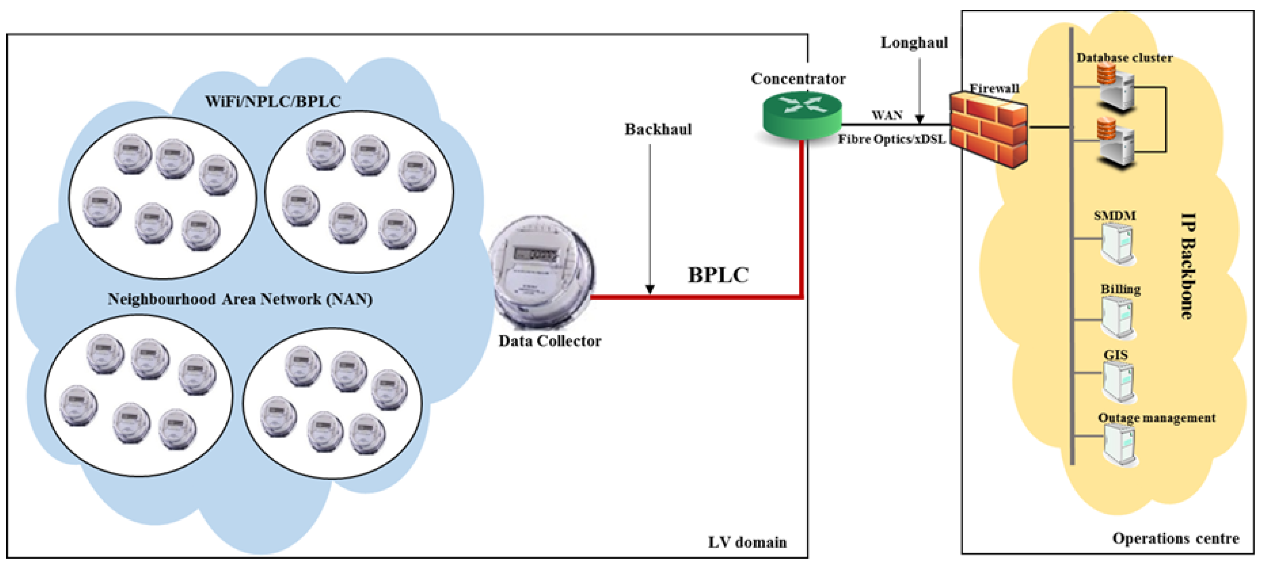
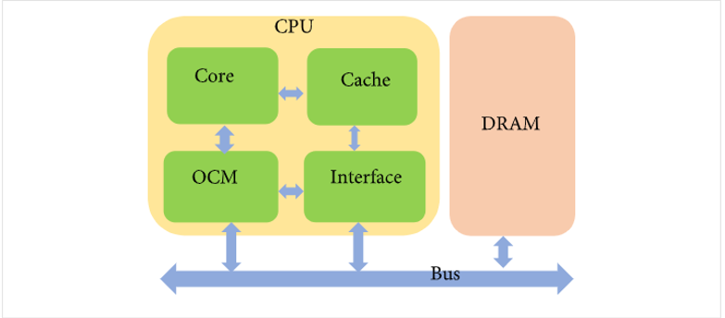
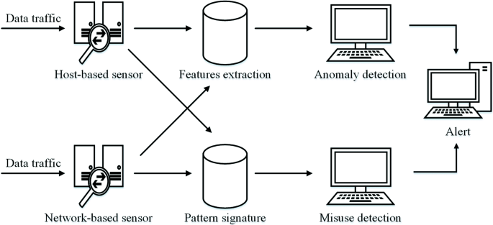

And the Results…
Embedded Firewall Implementation for service user gateway
IDS Tool Implementation for Cyberattack detection mechanism
Implemented On-Chip Memory Architecture

Slide 8
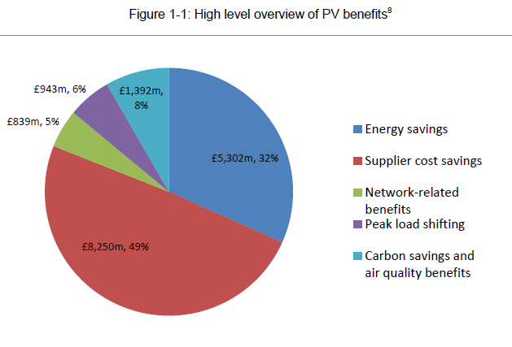
Benefits of Overall Implementation
Eliminated manual monthly meter readings
Monitors the electric system in real time
Encouraged more efficient use of power resources
Provides responsive data for balancing electric loads while reducing blackouts
Enabled dynamic pricing

Slide 9
Conclusion
Based on the evaluation of, time, budget and technical challenges, all the additional security measures were implemented.
Roll-Out was made live on the original planned date.
Business were very pleased on the way project team has shown utmost flexibility and have adapted to the changes.
It wouldn’t have been an easy task to overcome the hurdle without an experienced driving manager.
The Project Manager was awarded a “Delivery Excellence” Award for managing this challenge.
The Solution stands strong defending all the cyberattacks, thanks to SAE’s future proof design.

Slide 10
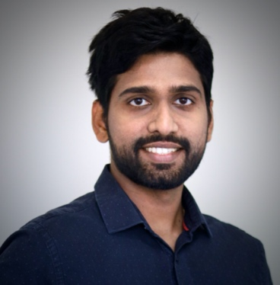
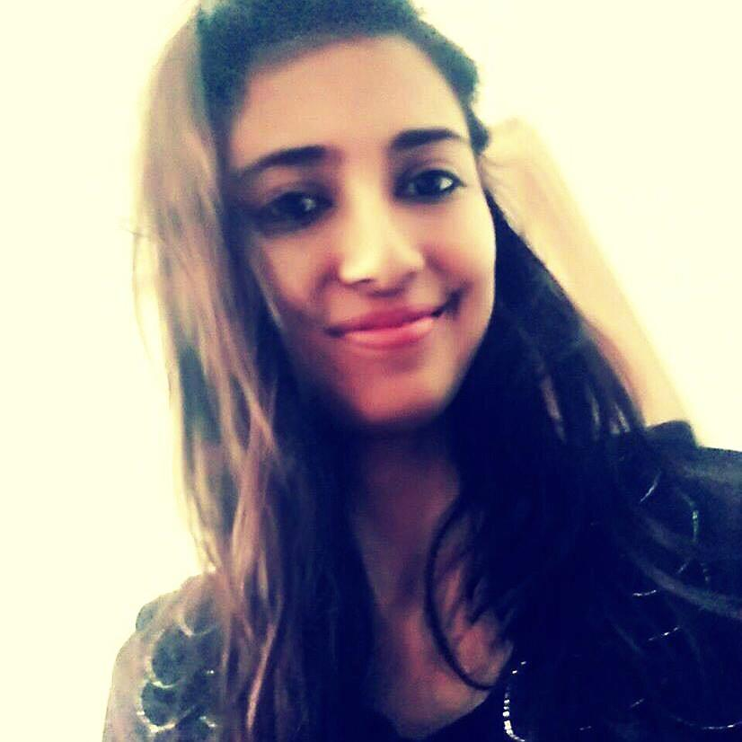
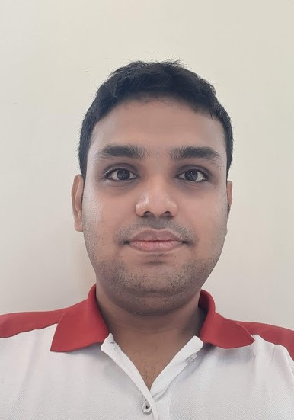
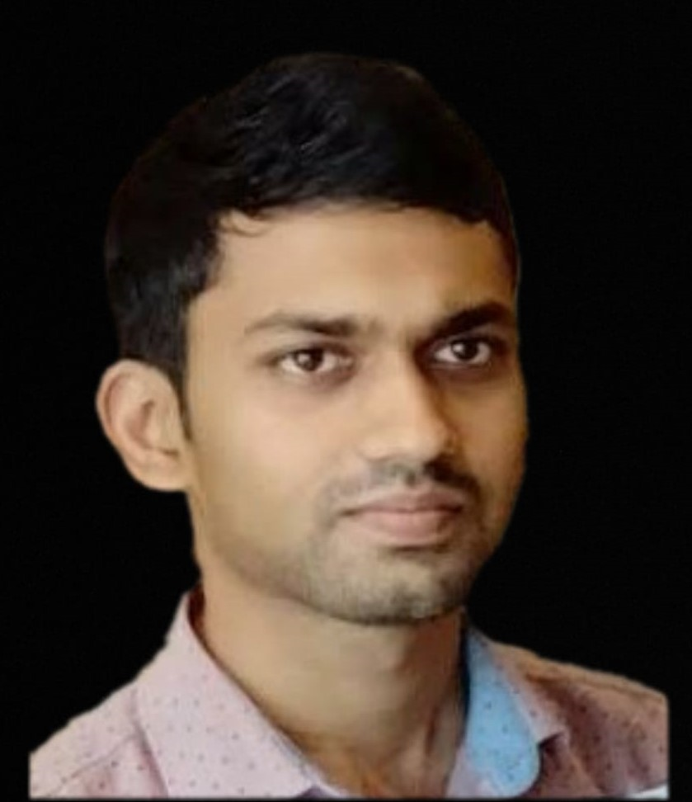
Thankyou
Umakanth is a Business Analytics and Information systems Graduate Student at the University of South Florida, Muma College of Business. He has 5+ years of IT experience working for two biggest energy suppliers in the UK as a Functional Test Lead and a smart metering functional consultant. He is proficient, ambitious, and dedicated technology professional with an understanding of Project Management, QA Consulting with a major skill set in areas of Functional Test Management, Data Analysis, SQL Database design with domain expertise in Energy, Utilities.
Meghla is a Business Analytics and Information Systems Graduate Student at the University of South Florida. She is a former Software Engineer with about 5 years of experience in Tata Consultancy Services Ltd. Expertise working for multiple clients in Banking and Finance domains as Technical Lead. She had worked on a few challenging projects for a major US Banking & Financial organization and subsequently received several “On The Spot” & Star performer award for excellence in performance. Her principal research interest in business analytics, which she intends to pursue intensively.
Samarpan is a Graduate student at USF Muma College of Business, currently pursuing his Master's in Business Analytics and Information Systems. He completed his graduation in Computer Science and Engineering from West Bengal University of Technology, India. During his UG, he was actively involved in academic research. Some of his valuable contribution includes performance optimized clustering to detect Brain Hemorrhage etc. He also brings with him 2 years of first-hand industry experience as he was working with ITC Infotech as Junior Business Analyst prior to joining USF.
Venu is a Business Analytics and Information Systems Graduate Student at the University of South Florida. He was a Senior Software Engineer with 3+ years of experience. He had worked mainly on developing and enhancing the features of e-commerce platform for the major apparel brand. He is also proficient in Backend Technologies and SQL Databases. He was rewarded for his major contributions and mentorship towards his project. Currently his career interests lies in Data Analytics field.
VP
Vanshika is a graduate student at University of South Florida, pursuing master’s in Business Analytics and Information Systems. She has a master’s degree in Business Studies as well. She worked with Cognizant Technology Solutions as an iOS developer for a brief period. She is a powerful force in the workplace and uses her positive attitude and tireless energy to encourage others to work hard and succeed. In her free time, Vanshika likes to hike, play tennis and play video games.

